Slide 1
Lecture 12

Slide 2
The Model View
Controller Pattern

Slide 3
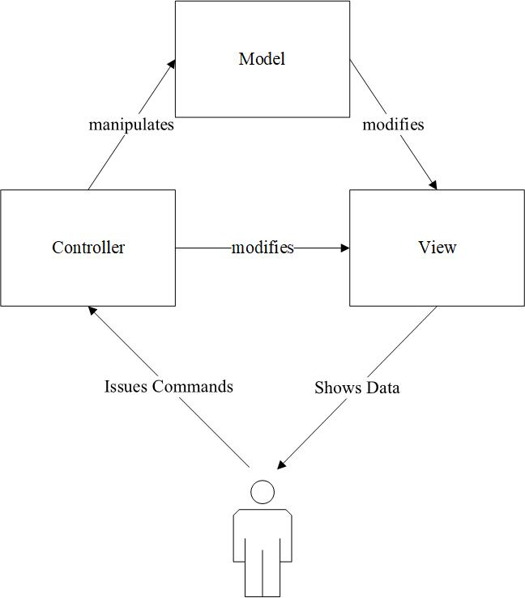
The MVC Architectural Pattern

Slide 4
The Model
public class Model extends PropertyChangeSupport {
// code
public void updateView() {
firePropertyChange(null, null, null);
}
}

Slide 5
The View
public class View implements PropertyChangeListener {
// code
public void propertyChange(PropertyChangeEvent event) {
// refresh view using data
}
}

Slide 6
MVC Implementation
The view is responsible for all the presentation issues.
The model holds the application object
The controller takes care of the response strategy

Slide 7
MVC Benefits
Cohesive Modules
Flexibility
Low Coupling
Adaptable Modules
Suitability for using in distributed systems

Slide 8
Drawing Program

Slide 9
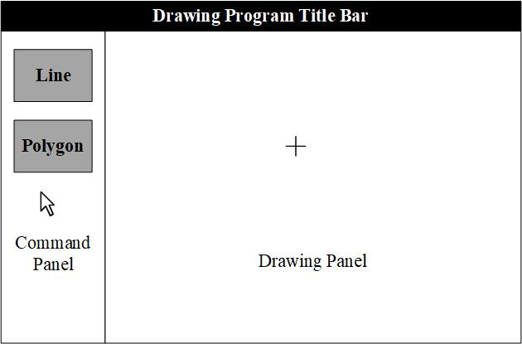
Drawing Program Structure

Slide 10
The GUI technology may change
Isolate what could change.
This way, if and when the rendering and inputting technology changes, we can more easily make the necessary changes.
Also, the drawing logic would be more based on OO principles and could be rewritten in a different technology, if needed.

Slide 11
Use Interfaces
Controller Interface
View Interface
GUI Input
Concrete Controller
Drawing Program Logic
Concrete
View
GUI
Output

Slide 12
Setting Up the Controller

Slide 13
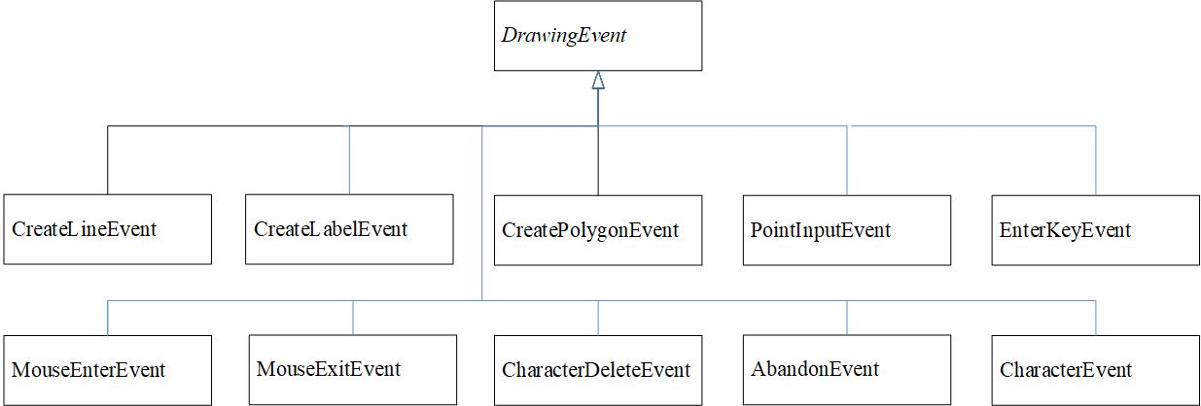
The Controller Interface

Slide 14
The Controller Interface
public interface Controller {
public void handleEvent(CreateLineEvent event);
public void handleEvent(MouseEnterEvent event);
public void handleEvent(MouseExitEvent event);
public void handleEvent(PointInputEvent event);
public void handleEvent(CreatePolygonEvent event);
public void handleEvent(CreateLabelEvent event);
public void handleEvent(CharacterEvent event);
public void handleEvent(DeleteCharacterEvent event);
public void handleEvent(AbandonEvent event);
public void handleEvent(ConfirmEvent event);
public void handleEvent(FXViewEvent event);
public void handleEvent(SwingViewEvent event);
}

Slide 15
Drawing Logic

Slide 16
Use Case for Drawing a Line
Actor | System
1. The user clicks on the Line button in the command panel and moves the cursor to the drawing panel
 | 2. The cursor takes the drawing cursor shape
3. The user clicks first on one end point and then on the other end point of the line to be drawn.
 | 4. The system adds a line segment with the two specified end points and displays the line on the screen.

Slide 17
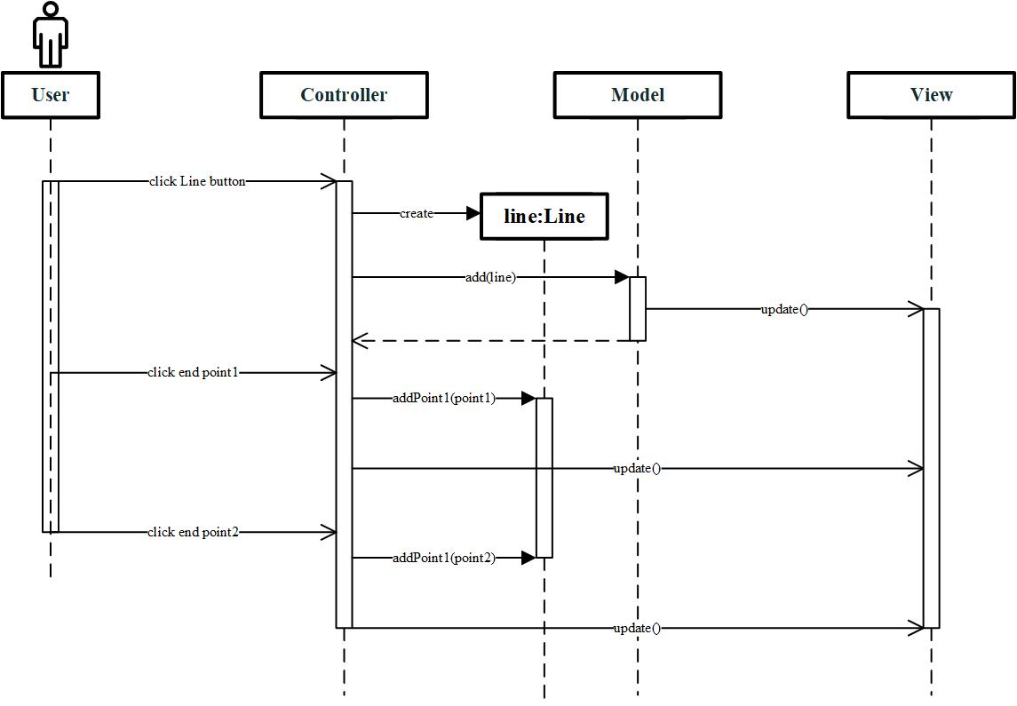
Drawing Process (Example: Drawing a Line)

Slide 18
Options for Implementing the Functionality
Just one big controller for all commands
One state for each command and each step of a command
One state per command

Slide 19
We Choose the Third Appoach
Quiescent State. No drawing is in progress.
For other shapes: One state per shape/command

Slide 20
DrawingState
public class DrawingState {
public void enter() {
}
public void leave() {
}
public void handleEvent(CreatePolygonEvent event) {
}
public void handleEvent(MouseEnterEvent event) {
LogicalViewImpl.instance().setsCursorToDrawing();
}
public void handleEvent(MouseExitEvent event) {
LogicalViewImpl.instance().setCursorToDefault();
}
// Not all methods shown
}

Slide 21
Quiescent State
public class QuiescentState extends DrawingState {
public void enter() {
LogicalViewImpl.instance().setCursorToDefault();
}
public void leave() {
LogicalViewImpl.instance().setsCursorToDrawing();
}
public void handleEvent(CreatePolygonEvent event) {
DrawingContext.instance().changeCurrentState(PolygonFirstInputState.instance());
}
public void handleEvent(OpenRequestEvent event) {
Model.instance().retrieve(event.getFile());
}
public void handleEvent(SaveRequestEvent event) {
Model.instance().save(event.getFile());
}
public void handleEvent(MouseEnterEvent event) {
LogicalViewImpl.instance().setCursorToDefault();
}
// Not all methods shown
}

Slide 22
The Model

Slide 23
The Model is a Collection
A collection of lines, polygons, and label objects.
The details of how each of these shapes is represented are unimportant at this stage.
A collection field to store the shapes.
Methods to add, access, and delete shapes.

Slide 24
The Model
Should also be able to communicate with one or more views.
Should be implemented as an observable of the Observer pattern with methods to add and remove views and update them when needed.

Slide 25
The View

Slide 26
We separate the view into …
A logical view: It decides how to render the items
A physical view: It renders the items for the GUI technology
In general, there can be multiple logical views: but we will not take this complicated approach
There can be multiple physical views

Slide 27
Drawing Shapes

Slide 28
There could be multiple renderers
Renderer using Java Swing
Rendered using JavaFX
Rendered using Java AWT
The drawing technology will change

Slide 29
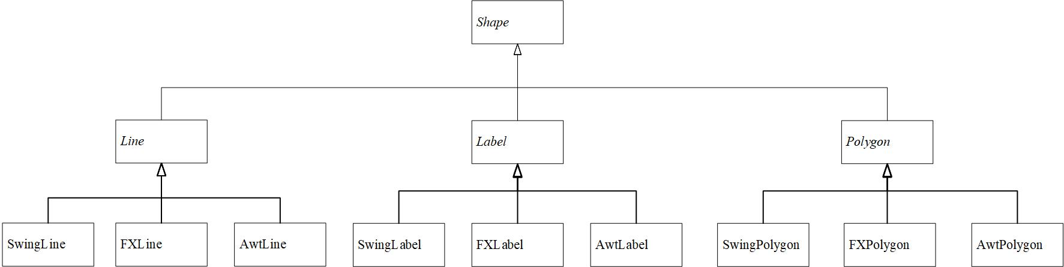
Catering to Multiple Renderers

Slide 30
Bridge Pattern
Number of Classes reduced from
Number of Types of Items X Number of UI Packages
to
Number of Types of Items + Number of UI Packages
Notes:
Another possibility
UIContext {
void drawLine(Point p1, Point p2);
void drawString(String string, RenderInfo info);
}

Slide 31
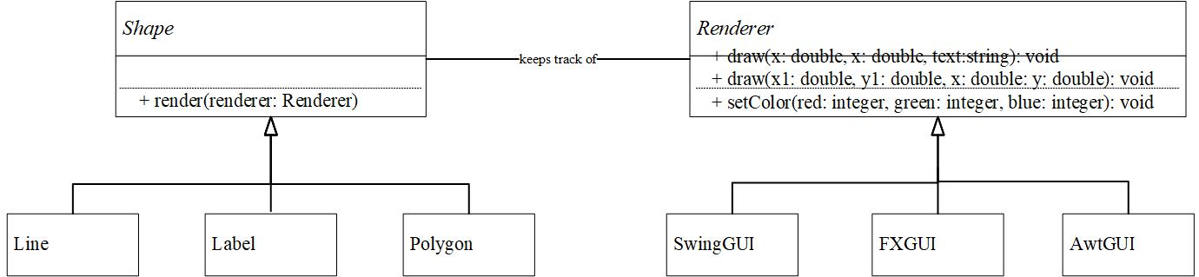
The Structure of the Bridge Pattern

